Slide 1
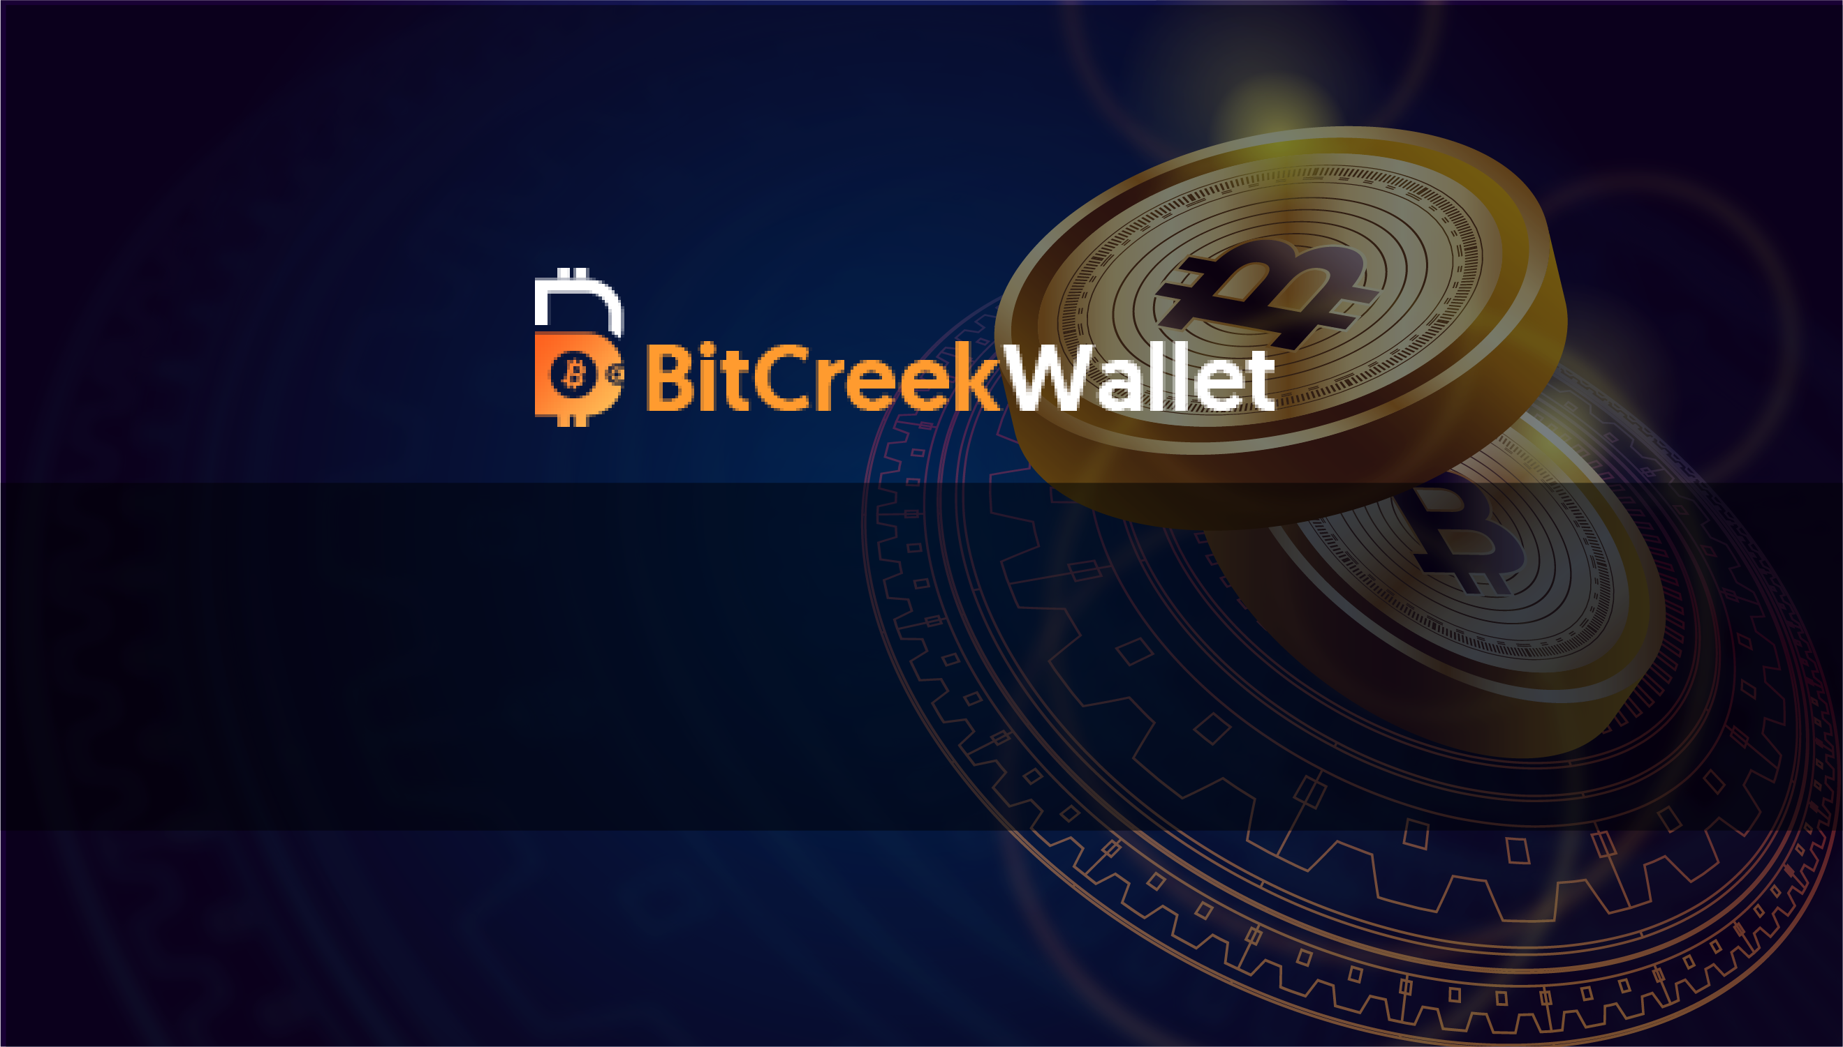
Download Our app and put your Coins to work for your dreams

Slide 2
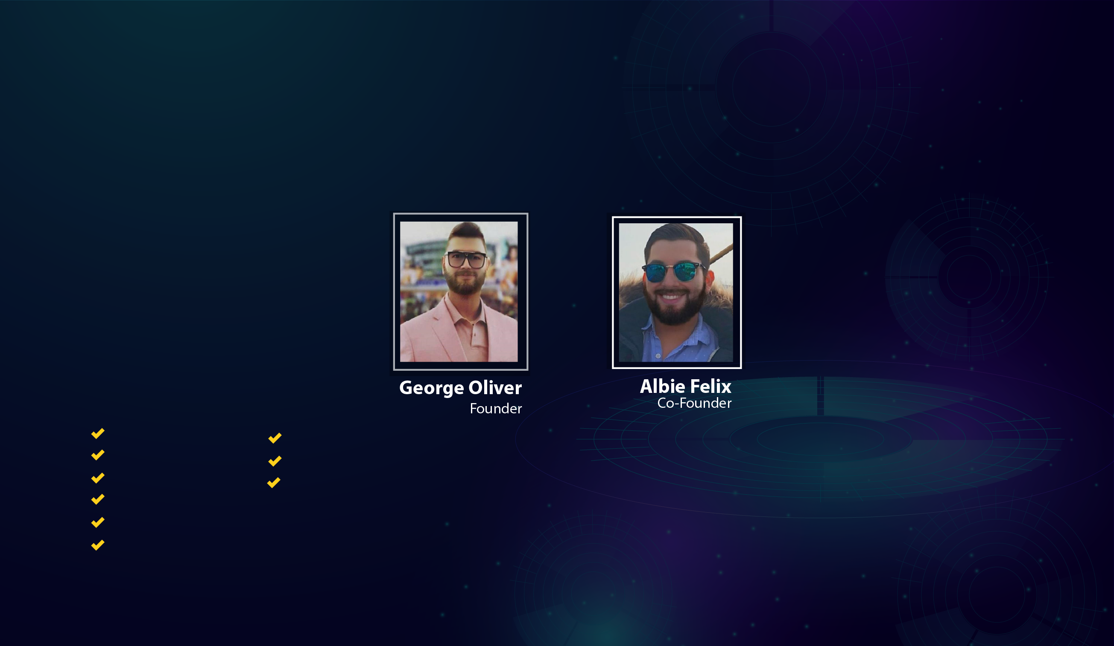
Our Team
Our team have highly experienced blockchain developers.
Oliver is a multidisciplinary specialist, cryptocurrency expert and professional advisor.
With over 4 years of experience in the crypto space, Oliver is currently helping startups to achieve success. His experience, skills, critical mind and perfectionism allow him to do his work really well and enjoy the result.
He is Founder and Co-Founder of many tech companies and he supports several well known companies as a board member - including the supervisory board of BNP Paribas Cardif.
Felix holds degrees in maths, physics, finance and business from LMU in Munich, University of Wales, University of Nitra and Frankfurt School of Finance and Management. He has the theoretical aptitude to run a bank according to 33 Abs. 2 KWG, a debt collection company according to 10 Abs. 1 RDG and is certified as a rating advisor.
Andrey advises on:
Cryptocurrency investments
Fundraising
Operations
Marketing strategy
Content
Usual & IEO listings
Achievements:
Member of Alliance of Blockchain Professionals (ABP)
Current advisory portfolio includes 6 startups/companies
Experienced Cosmos Decentralized Blockchain Developer

Slide 3
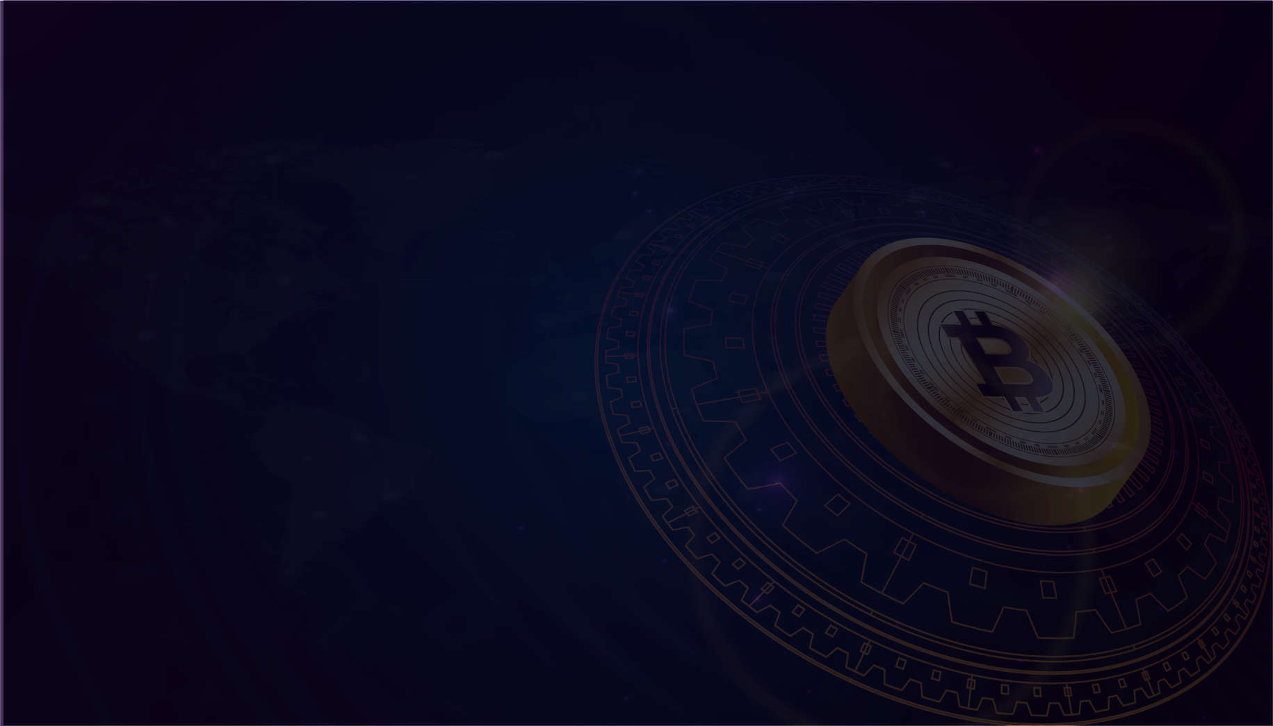
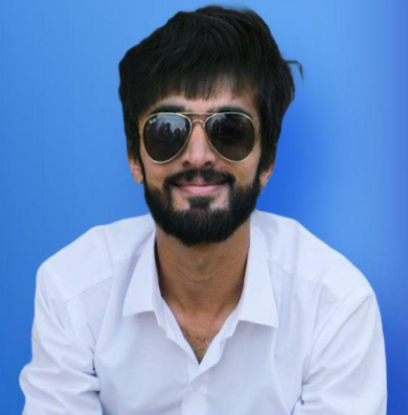
Jaseer invested into Bitcoin back in 2015 after finding out about it from a bunch of super smart developer friends. Ever since then he became increasingly more interested and invested in the Blockchain space. As a Computer Scientist, Jaseer took to Blockchain and understanding its proposition naturally. After further investing into more cryptocurrencies such as Ethereum, Dash, Litecoin and others, Jaseer got involved even more. In 2016 Jaseer started presenting actively about the future of fintech and predicting where the world will head with regards to FinTech. With a heavy experience of designing global award winning fintech systems for Amex, HSBC and Lloyd's Bank, Jason moved onto designing trading platforms too.
Jaseer Hamadan
CEO Of Bitcreek Wallet

Slide 4
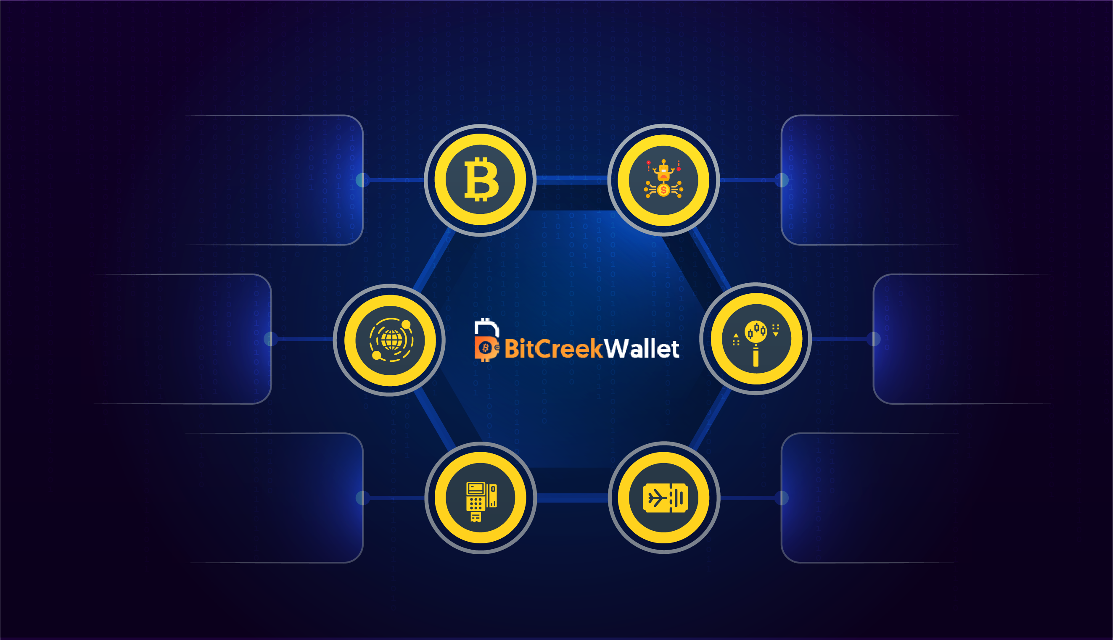
Bitcreek Wallet Platform
Store Hold & Earn Bitcreek
Tokens (BCWT)
AI Trading BOT
Integrated with World's
Top Exchanges
DEX with COSMOS
Network Like Binance
DEX
OTC Trading
POS ecommerce
Implementation
Air Ticketing With
Complete GDS services
(Hotels,Taxis)

Slide 5

Compensation Plan
Bitcreek Offer Three Types of Rewards:
01
02
03
Passive Rewards
Referral Rewards
Community
Rewards

Slide 6
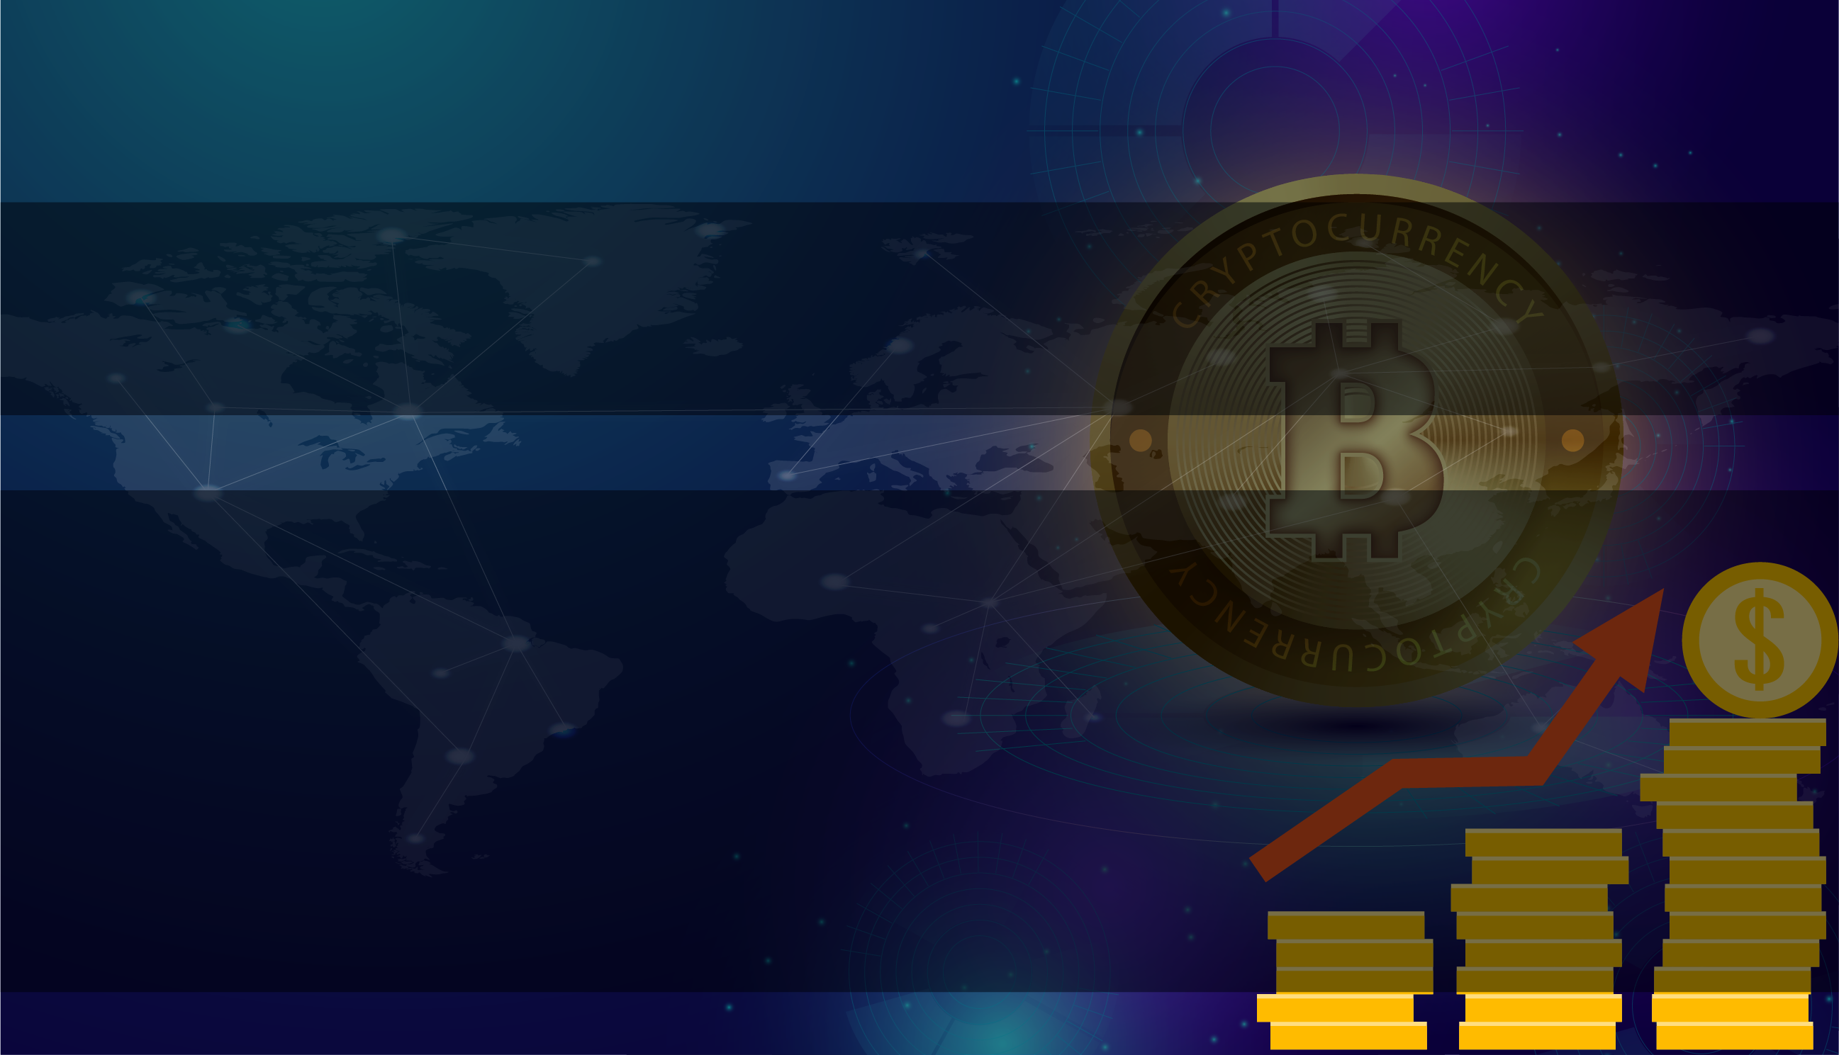
Example: Holding 1000$ worth of Coin will earn you 10$ worth of BCWT Tokens which you can exchange or hold for more gains.
Passive Rewards:
Simply Hold your Crypto coins in Bitcreek app & generate upto
1% daily Return.
***Note: Percentage may fluctuate depending on market conditions.

Slide 7
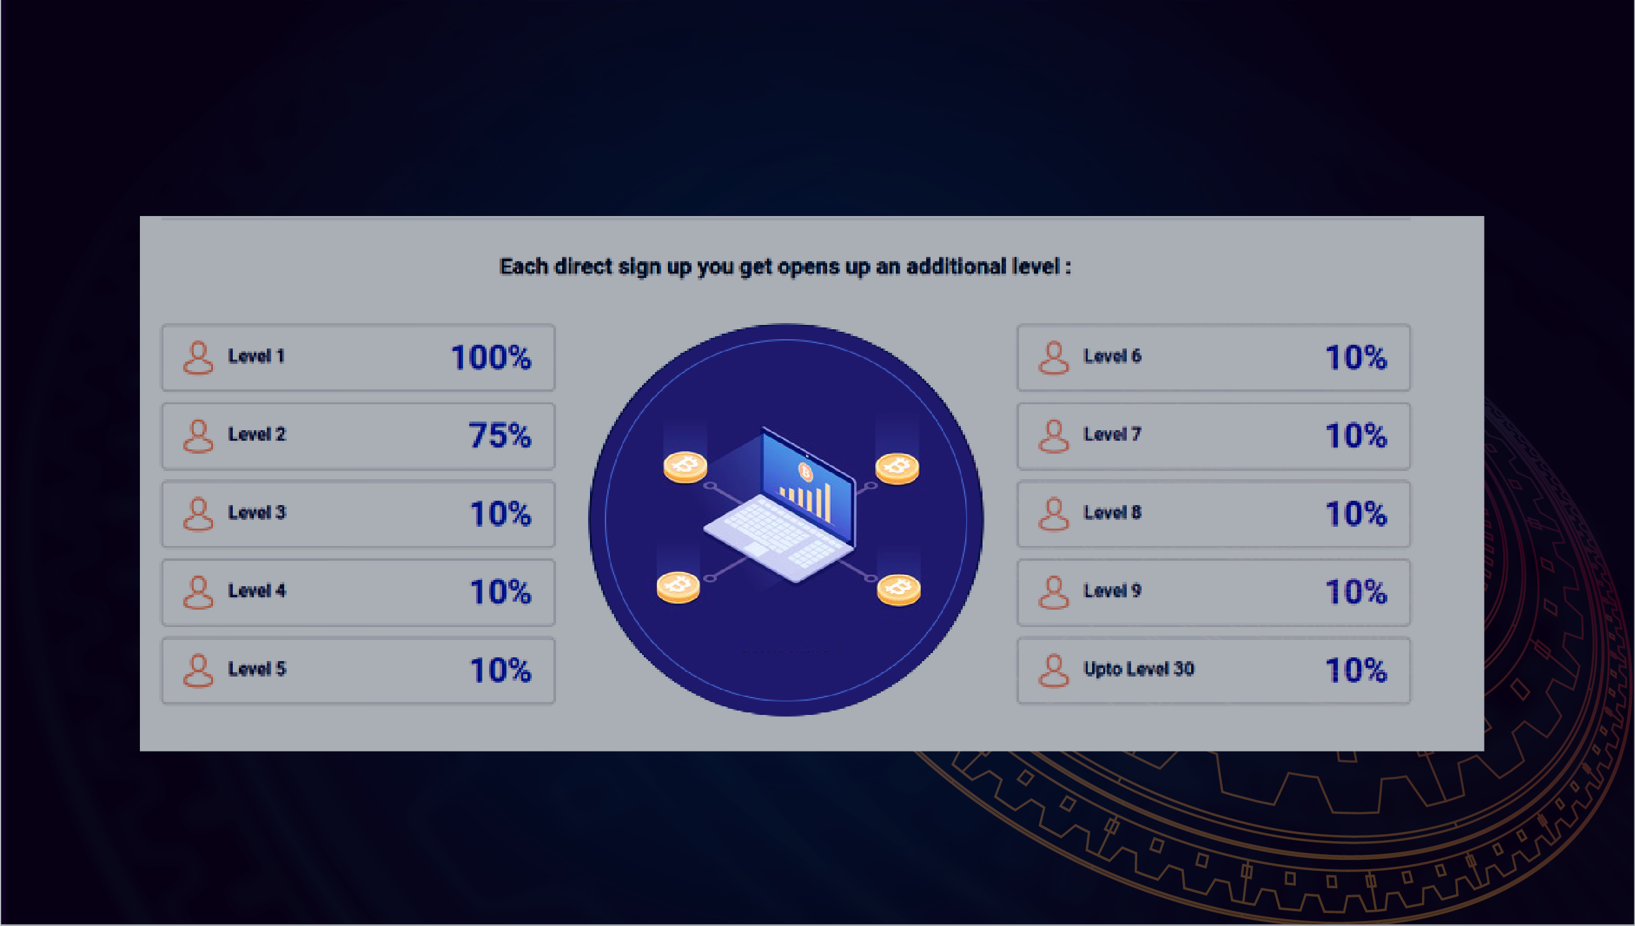
Referral Rewards:
100% Matching bonus upto 30 Levels Deep.
All commissions are being paid based on earnings of your partners. This type of commission
is often called matching bonus. With every new active direct partner, a new level in your structure will be unlocked.

Slide 8

Community Rewards:
Our team have highly experienced blockchain developers.
Tier 1:
Tier 2:
Tier 3:
When your team
volume Reach
When you get 3 Tier
1 under you
in 3 Different Legs
When you get 3 Tier
2 under you
in 3 Different Legs
100,000$

Slide 9

We are also Launching a Country Representative program in October. It will unlock additional 10% upto 30 Levels deep. This plan is only for first 1000 people who will receive Tier 3.
Country Representative:
Level
Qualification
Direct referrals
Matching
Bonus
T 1
T 2
T 3
Country Rep
01
01
100%
Extra 10%
Extra 20%
Extra 30%
Extra 40%
02
02
75%
Extra 10%
Extra 20%
Extra 30%
Extra 40%
01-30
03-16
10%
Extra 10%
Extra 20%
Extra 30%
Extra 40%

Slide 10
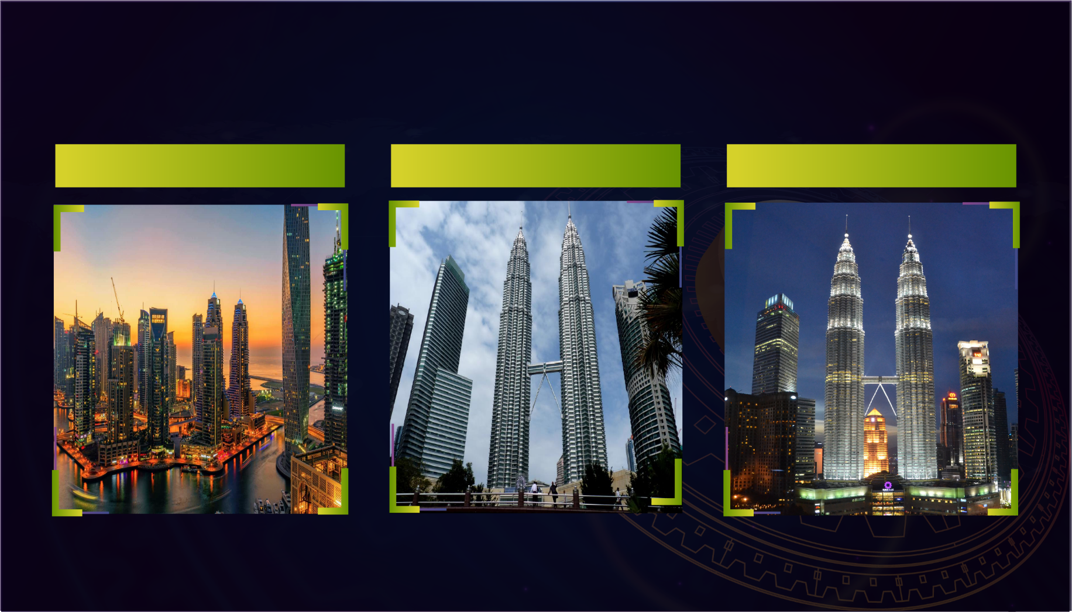
Meet & Greets
Dubai in January 2020
Indonesia in March 2020
Malysisa in June 2020

Slide 11
For Attending this Launch Event…
Thank you

